Slide 1

Nashville TN
This Photo by Unknown Author is licensed under CC BY

Slide 2
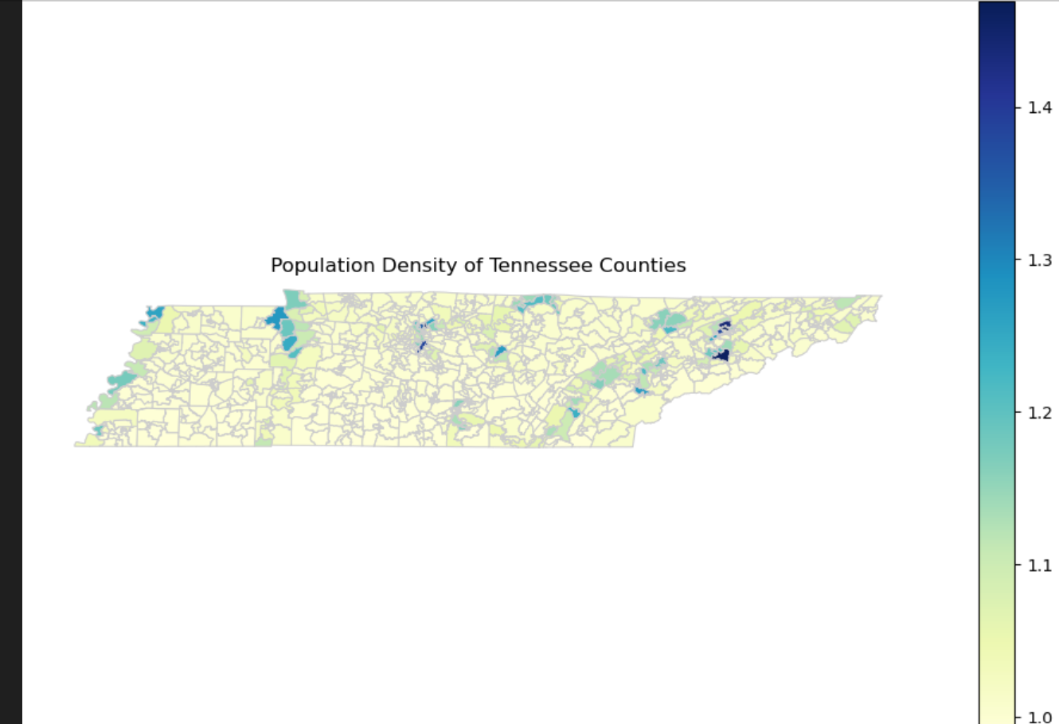
This type of map uses differences in shading or coloring within predefined areas, like counties, to indicate the density of population in those areas. The lighter colors likely represent lower population densities, while the darker colors indicate higher population densities. This map shows the state of Tennessee, with county boundaries marked and the population density represented by the color scale on the right side of the image. The color scale shows a gradient from light to dark, which corresponds to increasing population density values.

Slide 3
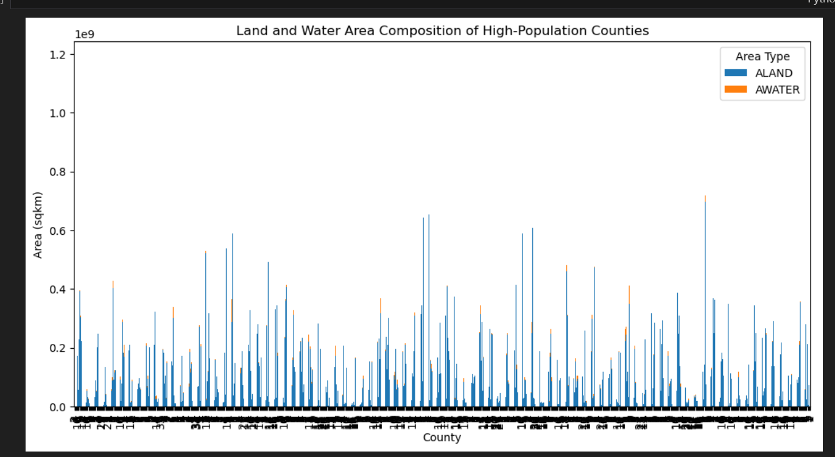
represents the land (ALAND) and water (AWATER) areas of various counties, which are indicated on the horizontal axis, with the area in square kilometers on the vertical axis. Each county has two bars adjacent to each other, one for land and one for water, which allows for a comparison between the two types of areas within each county

Slide 4
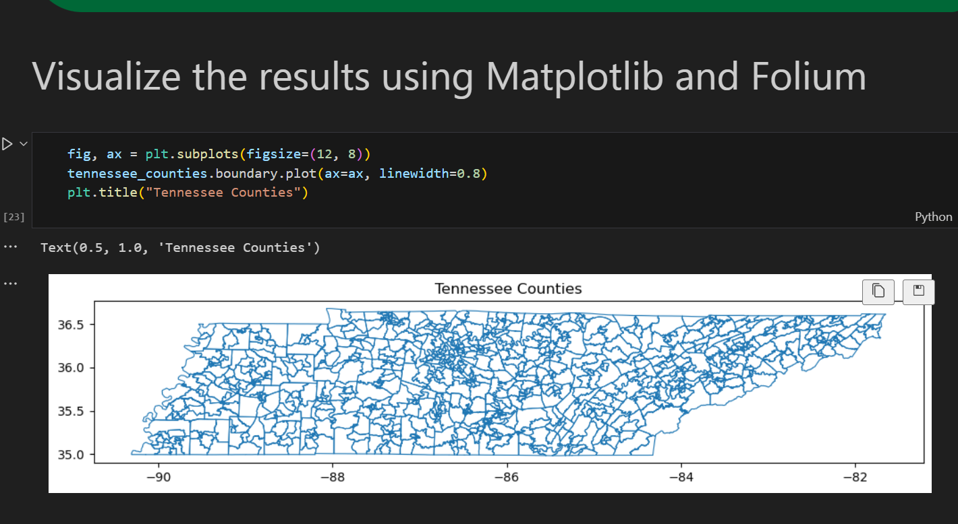
showing the county boundaries within the state of Tennessee. It is a simple, uncolored outline map that highlights the borders of each county. The latitude and longitude lines are also shown, providing a geographic framework for the map. This type of map is typically used as a base for creating more complex geospatial visualizations, such as showing demographic data, economic statistics

Slide 5
Assumptions
Here are a few general assumptions one might make:
Educational or Demonstrative Purpose: The map could be intended for educational purposes, possibly to demonstrate the relative locations of countries and continents without focusing on finer details.
Focus on Geographic Contours: The map highlights the contours of the continents and the vastness of the oceans, which could be used in a context where the discussion is about continental drift, plate tectonics, or oceanography.
Cartographic Design: The map's minimalistic design could be deliberate to emphasize a specific aspect, such as the size of countries, or to serve as a canvas for adding specific data layers in a Geographic Information System (GIS) application.

